Slide 1
ANGLEŠČINA ZA OTROKE

Slide 2
O AVTORICI
MARUŠA MALIGOJ, magistrica profesorica anglistike in ruščine
Dolgoletne izkušnje s poučevanjem individualnih in skupinskih tečajev angleškega jezika
Eramus+ praksa na osnovni šoli Dore Primary School v Sheffieldu, VB

Slide 3
PROGRAM
6 srečanj po 60 min
Termini
četrtek, 2. 4., 16.30-17.30
petek, 3. 4., 16.30-17.30
ponedeljek, 6. 4., 16.30-17.30
torek, 7. 4., 16.30-17.30
sreda, 8. 4., 16.30-17.30
četrtek, 9. 4., 16.30-17.30

Slide 4
KAJ SE BOMO NAUČILI?
HI, MY NAME IS: pozdravljanje, kako predstavimo sebe in druge
I’M SEVEN YEARS OLD: števila od 1 do 100
MY FAVORITE COLOR IS: osnovne barve
I HAVE A DOG: domače živali, živali na kmetiji, divje živali
IT’S SPRING!: meseci, letni časi
I LIKE APPLES: hrana in pijača
MY FAMILY: družina in družinski člani
MY MUM IS A TEACHER: poklici

Slide 5
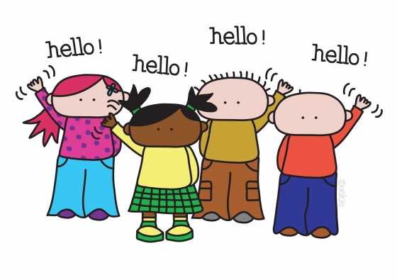
SAYING HELLO
HI
HELLO

Slide 6

SAYING HELLO
SAYING HELLO – POZDRAVLJANJE
MORNING
AFTERNOON
GOOD
EVENING
NIGHT

Slide 7

INTRODUCING YOURSELF
WHAT IS YOUR NAME?
WHAT’S YOUR NAME?

Slide 8
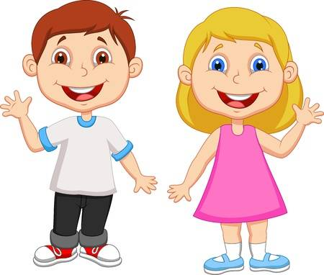
INTRODUCING YOURSELF
HELLO, MY NAME IS
CHRIS
NANCY

Slide 9
INTRODUCING YOURSELF
Hello, my name is Chris.
What’s your name?
Hi, my name is Nancy.
Nice to meet you.
Nice to meet you too.

Slide 10
INTRODUCING OTHERS
WHAT’S HIS NAME?
WHAT’S HER NAME?
His name is Chris.
Her name is Nancy.

Slide 11
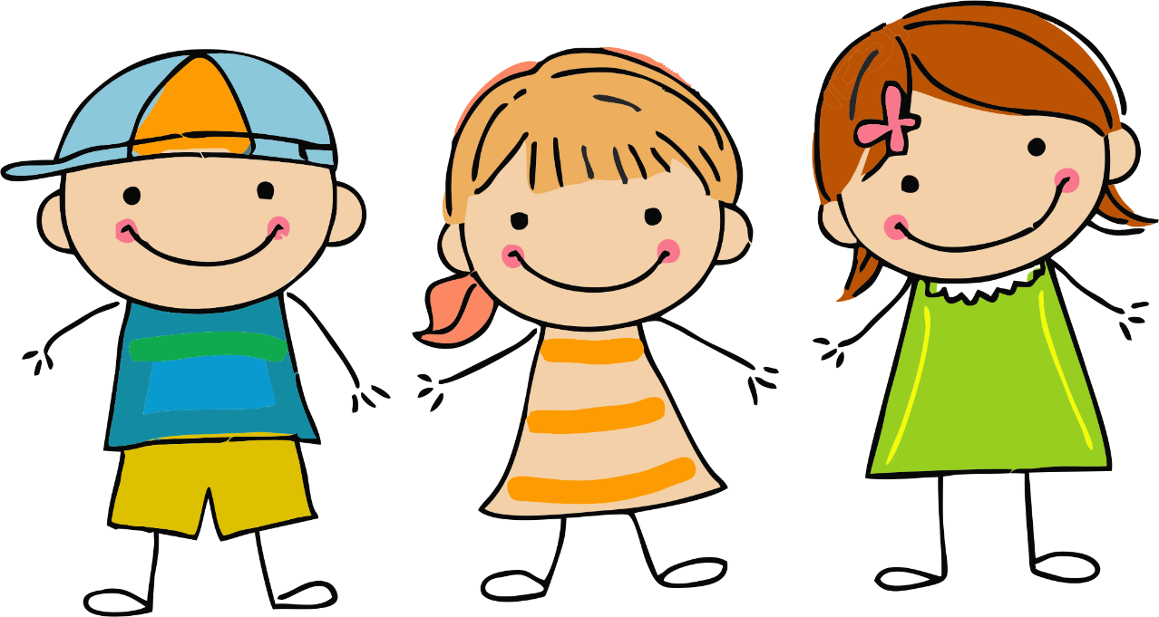
INTRODUCING OTHERS
WHAT ARE THEIR NAMES?
HIS
HER
name is
name is
Nick
Judy
HER
name is
Susie

Slide 12
INTRODUCING YOURSELF
HOW OLD ARE YOU?

Slide 13
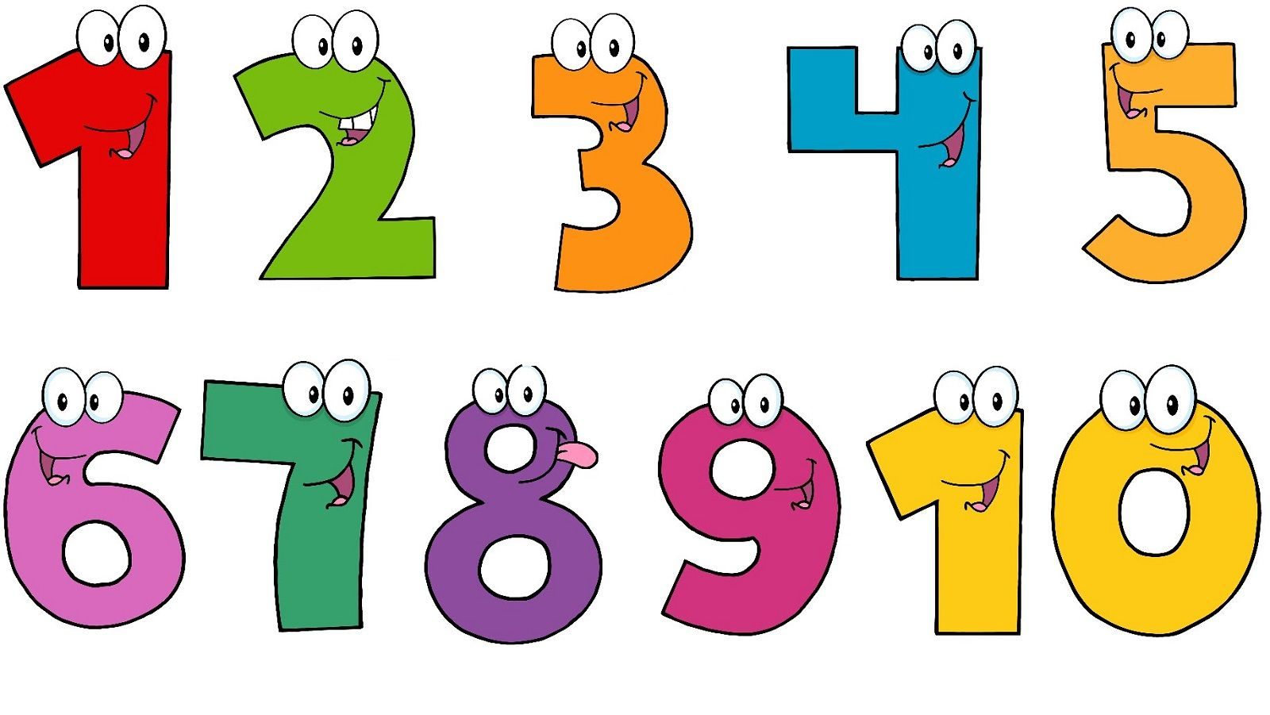
NUMBERS
ONE
TWO
THREE
FOUR
FIVE
SIX
SEVEN
EIGHT
NINE
TEN

Slide 14
INTRODUCING YOURSELF
I AM SEVEN
YEARS OLD.
I AM SIX
YEARS OLD.

Slide 15
INTRODUCING YOURSELF
Hello, my name is Chris.
What’s your name?
Hi, my name is Nancy.
Nice to meet you.
Nice to meet you too.
How old are you?
I am six years old.
And you?
I’m seven.

Slide 16
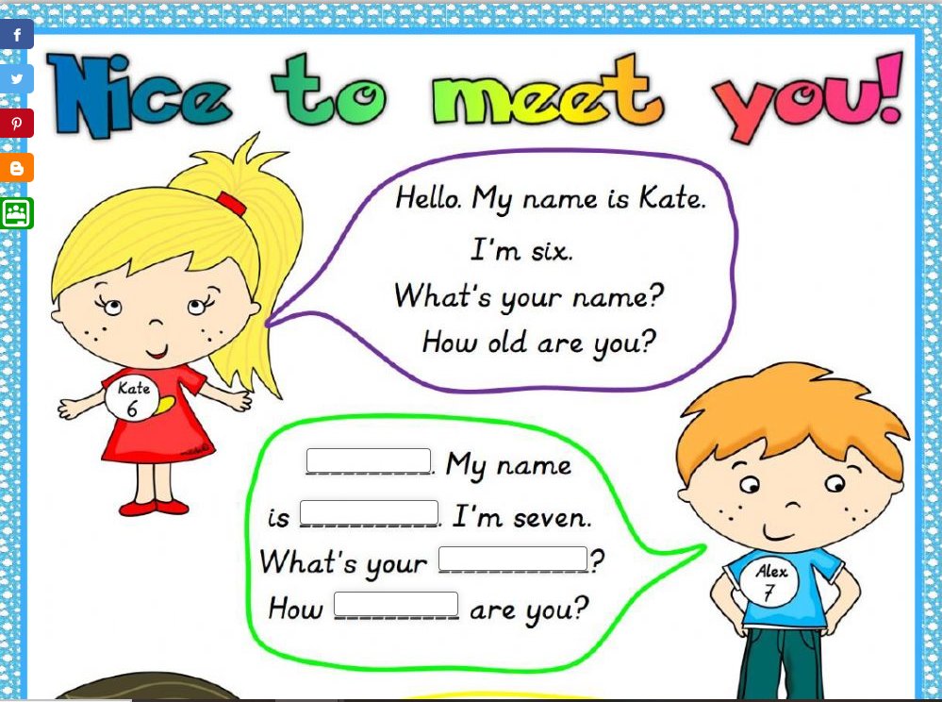
EXERCISE
Hi
Alex.
name
old

Slide 17
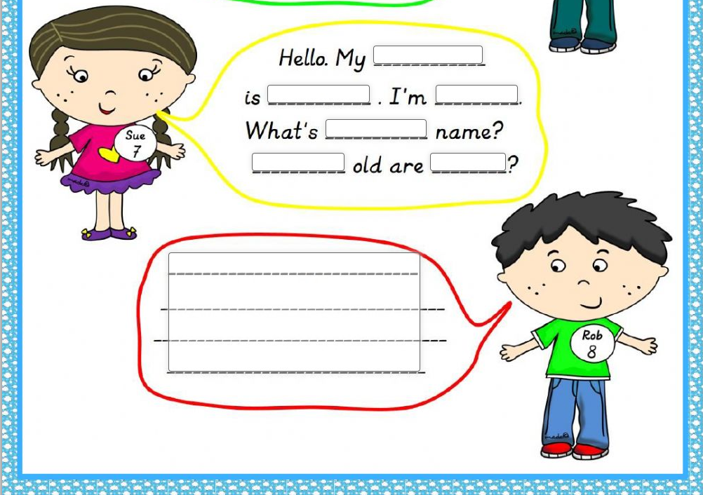
EXERCISE
name
Sue
seven
ZDRAVO
KAKO TI JE IME?
IME MI JE …
KOLIKO SI STAR/A?
STAR/A SEM _____ LET
your
Hello, Hi
How
you
What’s your name?
My name is …
Hi. My name is Rob.
I’m eight years old. What’s your name? How old are you?
How old are you?
I’m ___ years old.

Slide 18
HOW OLD ARE THEY?
They are five years old.
Nick/He is ten.
Susie/She is five.
Judy/She is five.
Nick
10
Susie
5
Judy
5

Slide 19
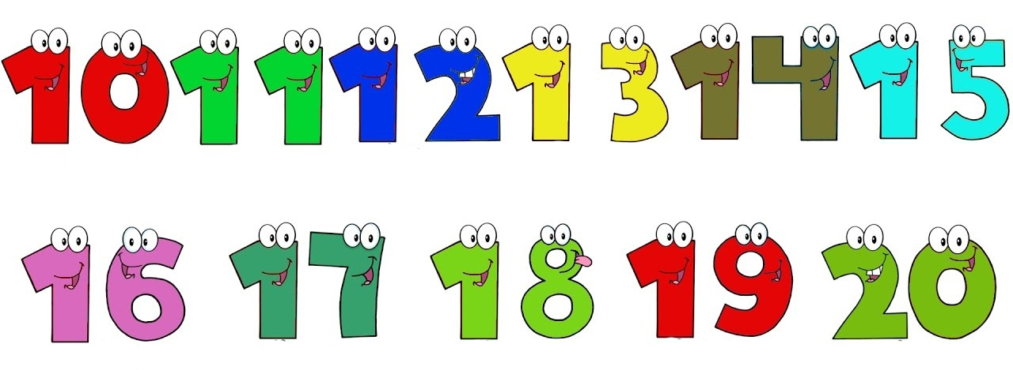
NUMBERS
TEN
ELEVEN
TWELVE
THIRTEEN
FOURTEEN
FIFTEEN
SIXTEEN
SEVENTEEN
EIGHTEEN
NINETEEN
TWENTY

Slide 20
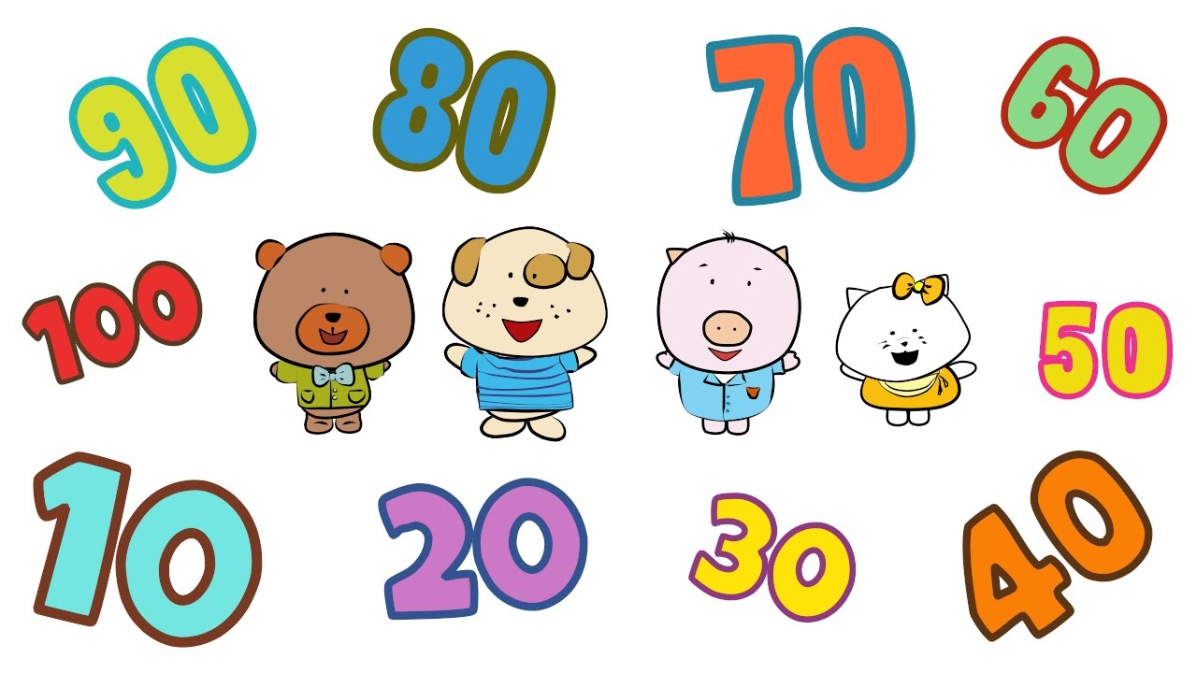
NUMBERS
NINETY
EIGHTY
SEVENTY
SIXTY
HUNDRED
FIFTY
TEN
TWENTY
THIRTY
FORTY

Slide 21
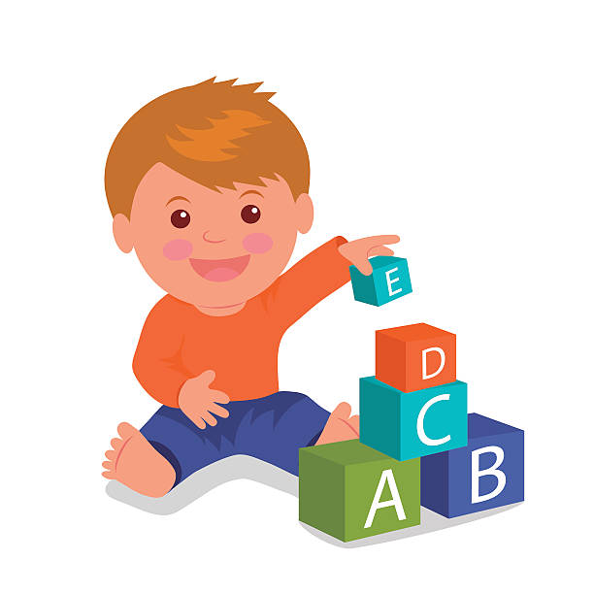
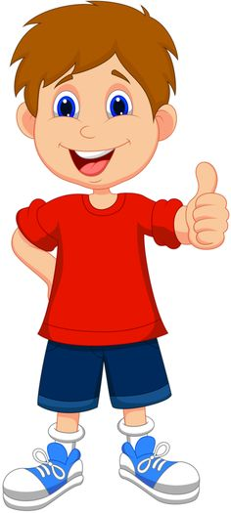
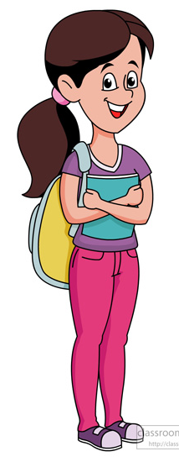
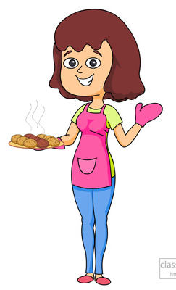
HOW OLD ARE THEY?
1
11
18
30
1) He is one year old.
2) He is eleven years old.
3) She is eighteen years old.
4) She is thirty years old.

Slide 22
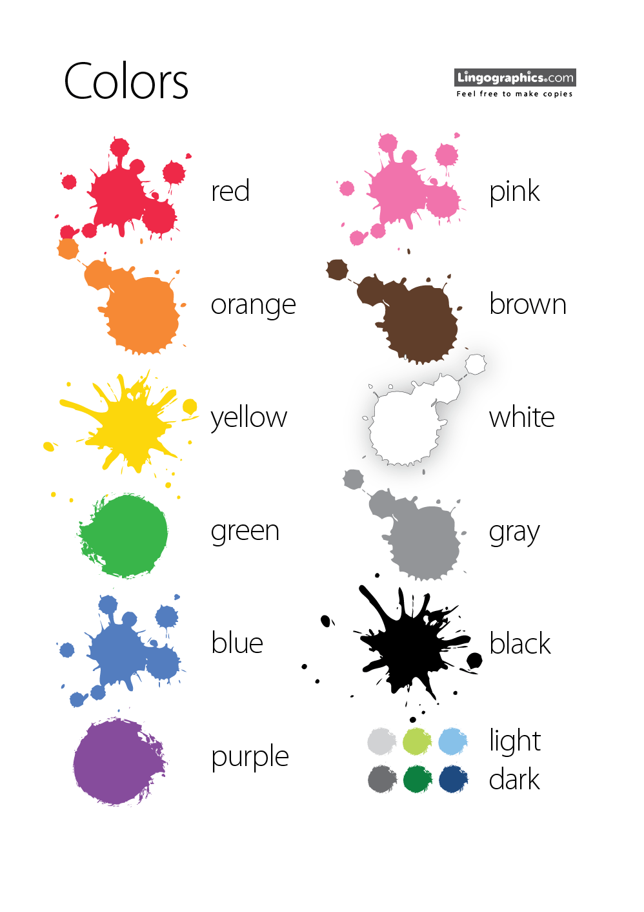
COLORS
YELLOW
ORANGE
RED
PINK
PURPLE
BLUE
GREEN
BROWN
GREY
WHITE
BLACK

Slide 23

EXERCISE
YELLOW
GREEN
BLUE
PURPLE
ORANGE
RED

Slide 24
WHAT’S YOUR FAVORITE COLOR?
My favorite color is …
GREEN
PINK
GRAY

Slide 25
WHAT’S YOUR FAVORITE COLOR?
What’s HIS favorite color?
What’s HER favorite color?
His favorite color is orange.
Her favorite color is yellow.

Slide 26
ANIMALS
DO YOU HAVE A PET?

Slide 27
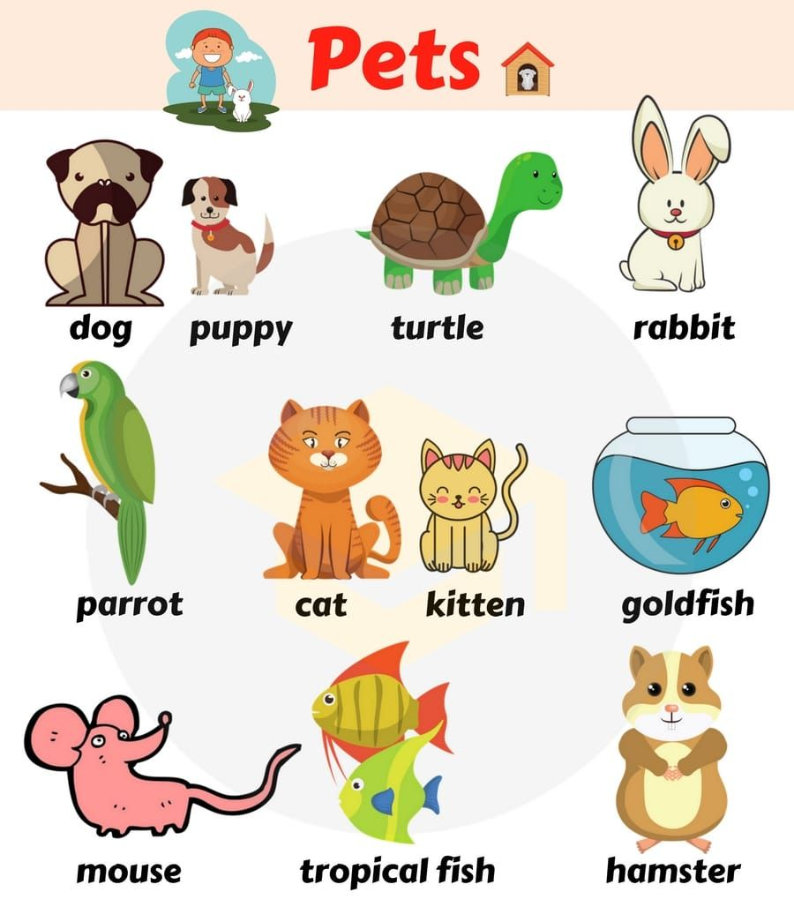
ANIMALS
YES, I / WE HAVE …
a dog / a puppy
a cat / a kitten
a rabbit
a hamster
a mouse
a parrot
a turtle
a goldfish
a tropical fish

Slide 28
ANIMALS
YES, I / WE HAVE …
one dog → two dogS
one cat → three catS
one rabbit → four rabbitS
one hamster → five hamsterS
one mouse → six MICE
one parrot → seven parrots
one turtle → eight turtleS
one goldfish → nine GOLDFISH

Slide 29
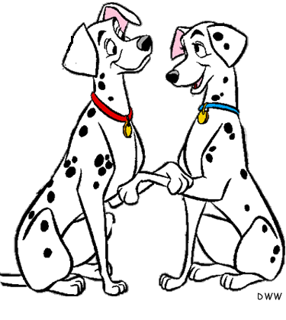
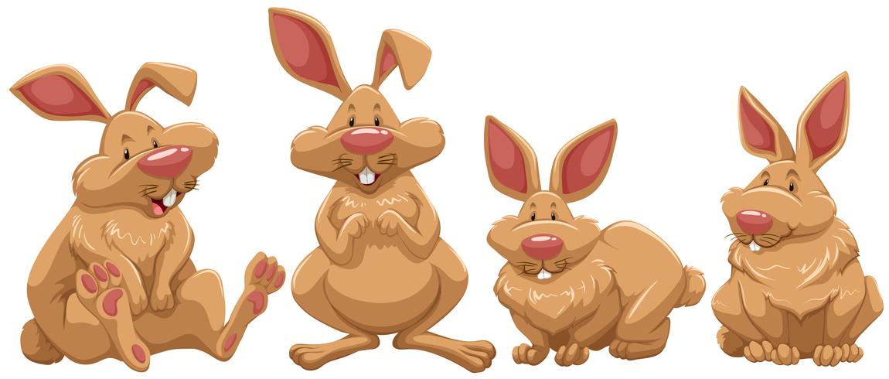
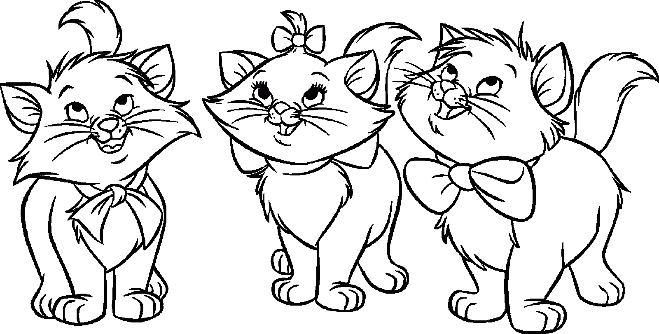
ANIMALS
WE HAVE
two dogs
four rabbits
three cats

Slide 30
ANIMALS
No, we DON’T HAVE a pet.
No, we DON’T HAVE any pets.

Slide 31
ANIMALS
DOES HE / SHE HAVE A PET?
Yes, he HAS.
Chris has a cat.
Yes, she HAS.
Nancy has a dog.
No, he doesn’t.
No, she doesn’t.

Slide 32
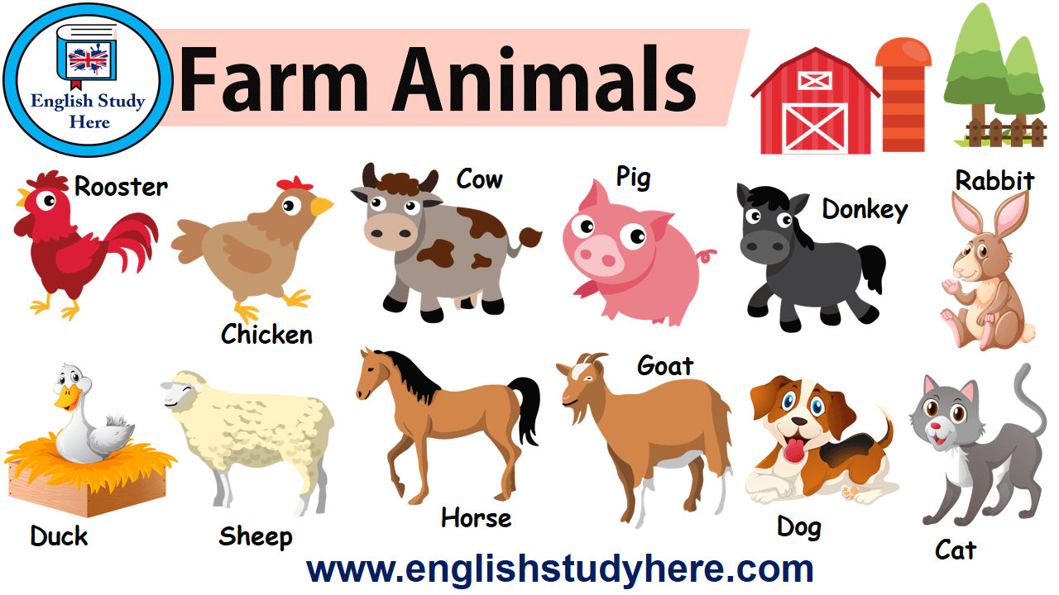
FARM ANIMALS

Slide 33
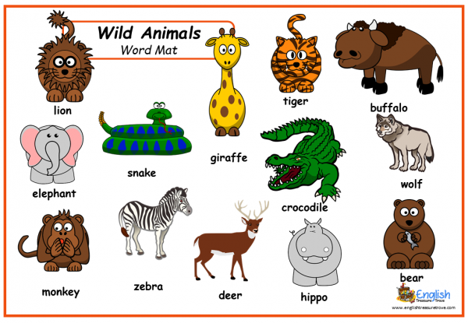
WILD ANIMALS

Slide 34
FAVORITE ANIMALS
WHAT IS YOUR FAVORITE ANIMAL?
WHAT IS HIS FAVORITE ANIMAL?
WHAT IS HER FAVORITE ANIMAL?

Slide 35
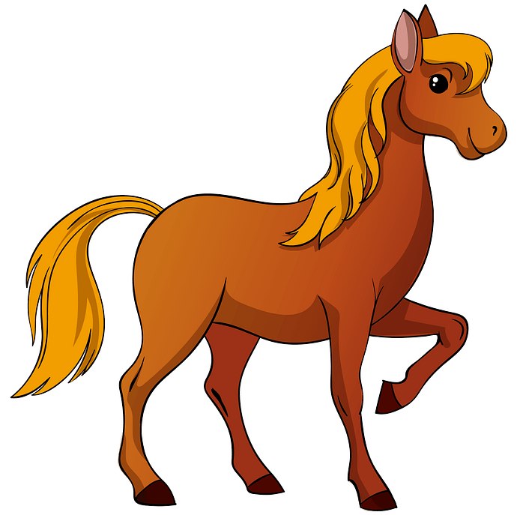
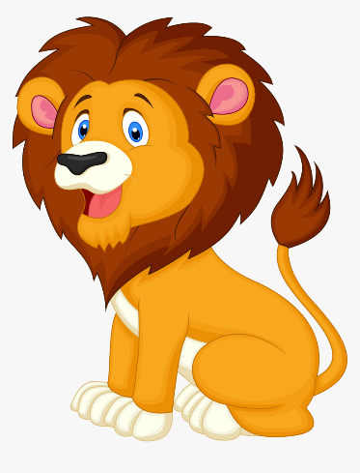
FAVORITE ANIMALS
My favorite animal is the dog.
His favorite animal is
the horse.
Her favorite animal is
the lion.

Slide 36
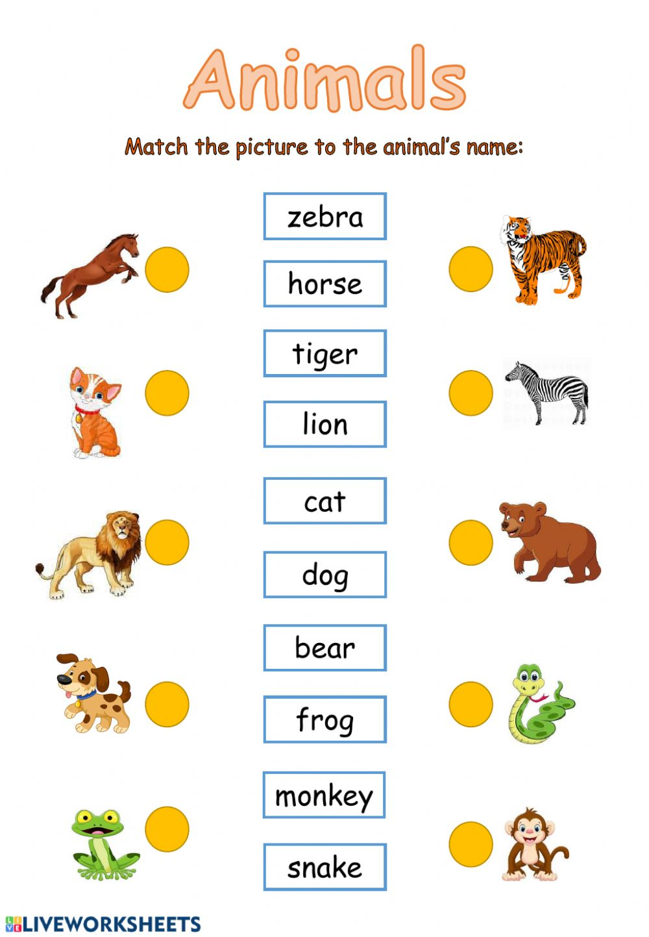
EXERCISE

Slide 37
EXERCISE
The lion is _________.
The giraffe is _________.
The elephant is _________.
The tiger is _________.
The crocodile is _________.
The zebra is _________ and _________.
BROWN
YELLOW
GRAY
ORANGE
GREEN
BLACK
WHITE

Slide 38
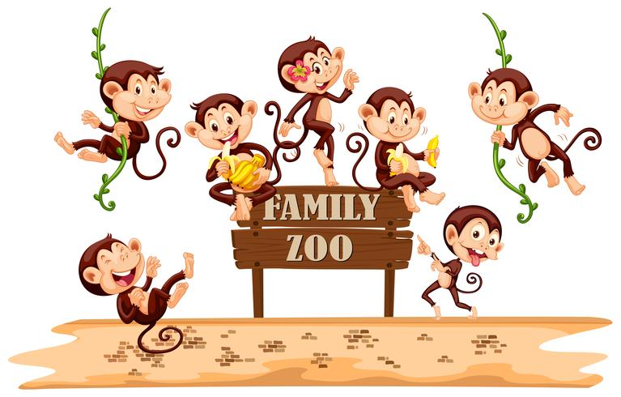
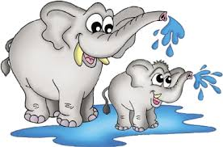
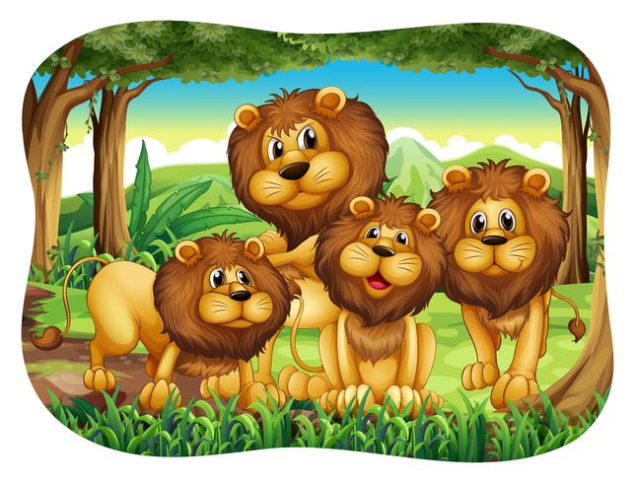
HOW MANY ANIMALS ARE AT THE ZOO?
SEVEN
MONKEYS
TWO
FOUR
ELEPHANTS
LIONS

Slide 39
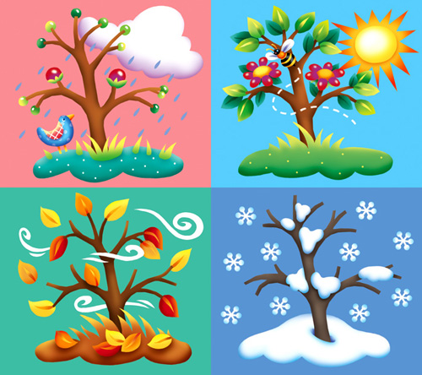
SEASONS
SPRING
SUMMER
FALL
WINTER
AUTUMN

Slide 40
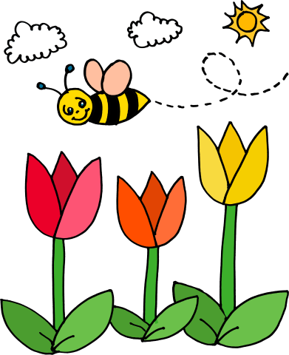
SEASONS
WHAT SEASON IS IT RIGHT NOW?
IT IS
SPRING

Slide 41
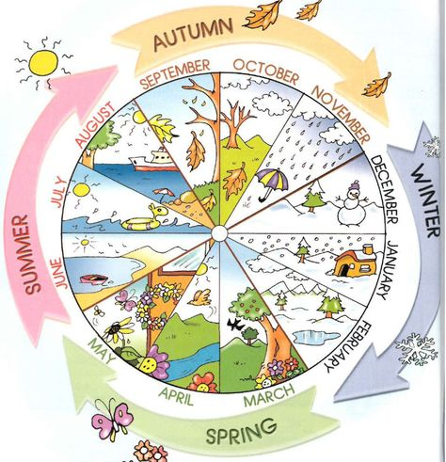
MONTHS OF THE YEAR
JUNE
SEPTEMBER
JULY
OCTOBER
AUGUST
NOVEMBER
MARCH
DECEMBER
APRIL
JANUARY
MAY
FEBRUARY

Slide 42
MONTHS
WHAT MONTH IS IT RIGHT NOW?
IT IS
APRIL

Slide 43
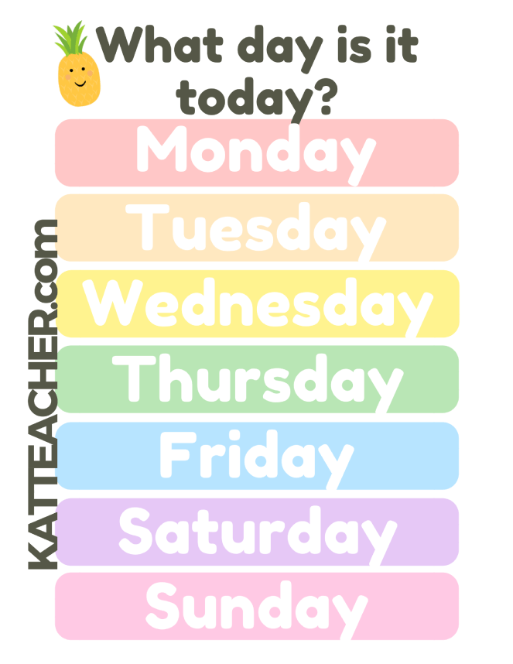
DAYS OF THE WEEK
PONEDELJEK
TOREK
SREDA
ČETRTEK
PETEK
SOBOTA
NEDELJA

Slide 44

DAYS OF THE WEEK
WHAT DAY IS IT TODAY?
IT IS

Slide 45
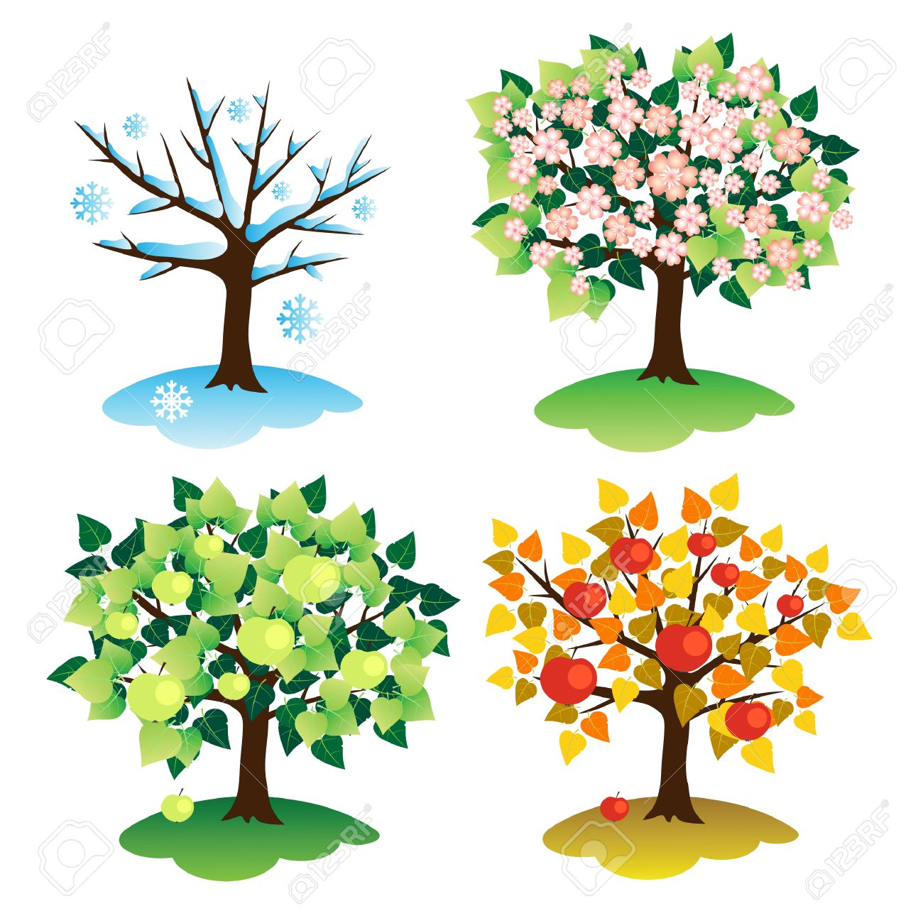
EXERCISE
WINTER
SUMMER
AUTUMN
SPRING
DECEMBER
JUNE
SEPTEMBER
MAY
JANUARY
JULY
OCTOBER
MARCH
FEBRUARY
AUGUST
NOVEMBER
APRIL

Slide 46
FAVORITE MONTHS & SEASONS
WHAT IS YOUR FAVORITE SEASON?
WHAT IS YOUR FAVORITE MONTH?

Slide 47
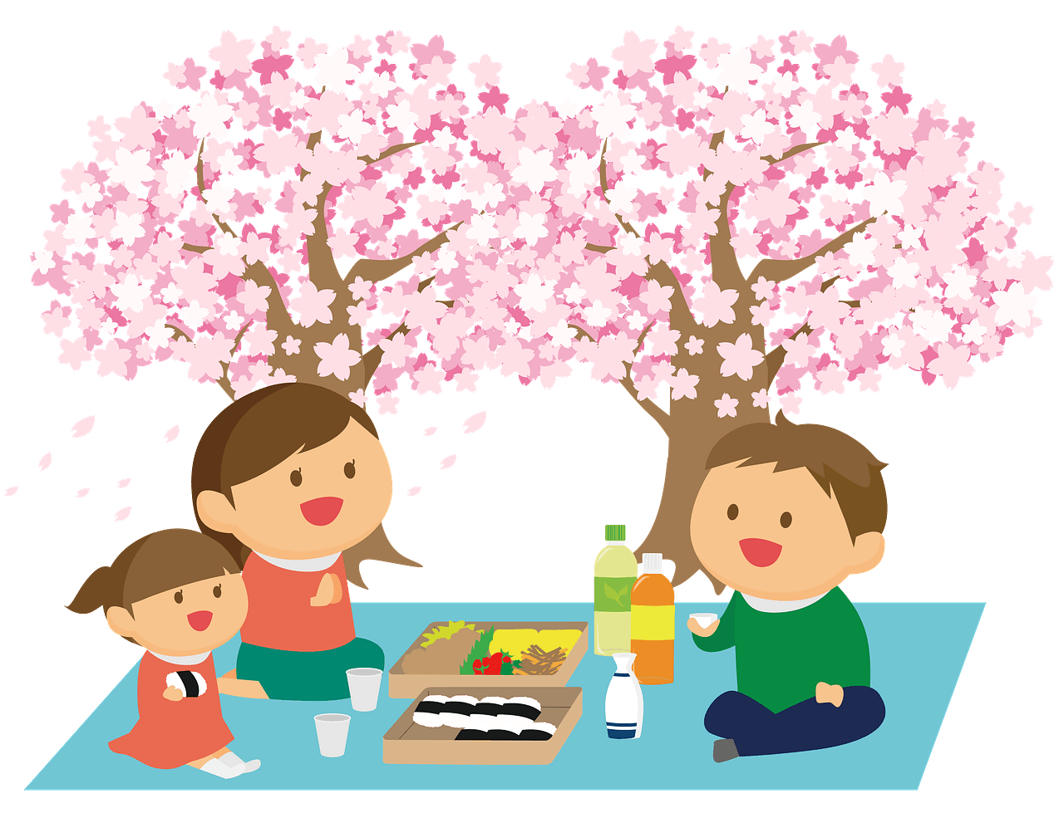
FAVORITE MONTHS & SEASONS
My favorite season is
SPRING
My favorite months is
MAY

Slide 48
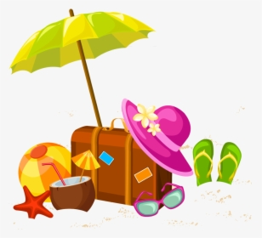
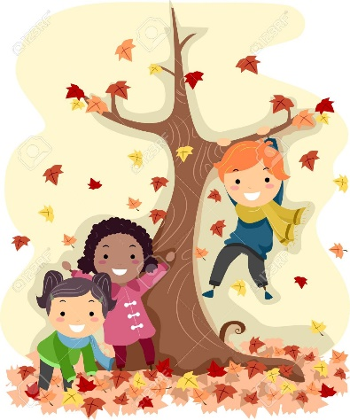
FAVORITE SEASONS
What is his/her favorite season?
What is his/her favorite month?
His favorite season is
summer.
Her favorite season is
autumn.
His favorite months is
August.
Her favorite month is
October.

Slide 49
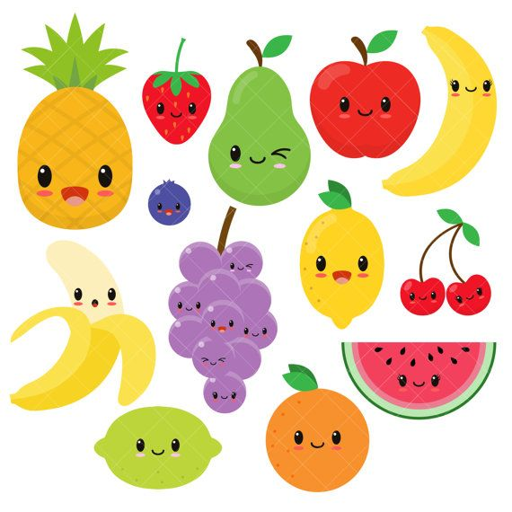
FOOD - FRUIT
PEAR
APPLE
BANANA
STRAWBERRY
PINEAPPLE
LEMON
BLUEBERRY
CHERRY
GRAPES
WATERMELON
ORANGE
LIME

Slide 50
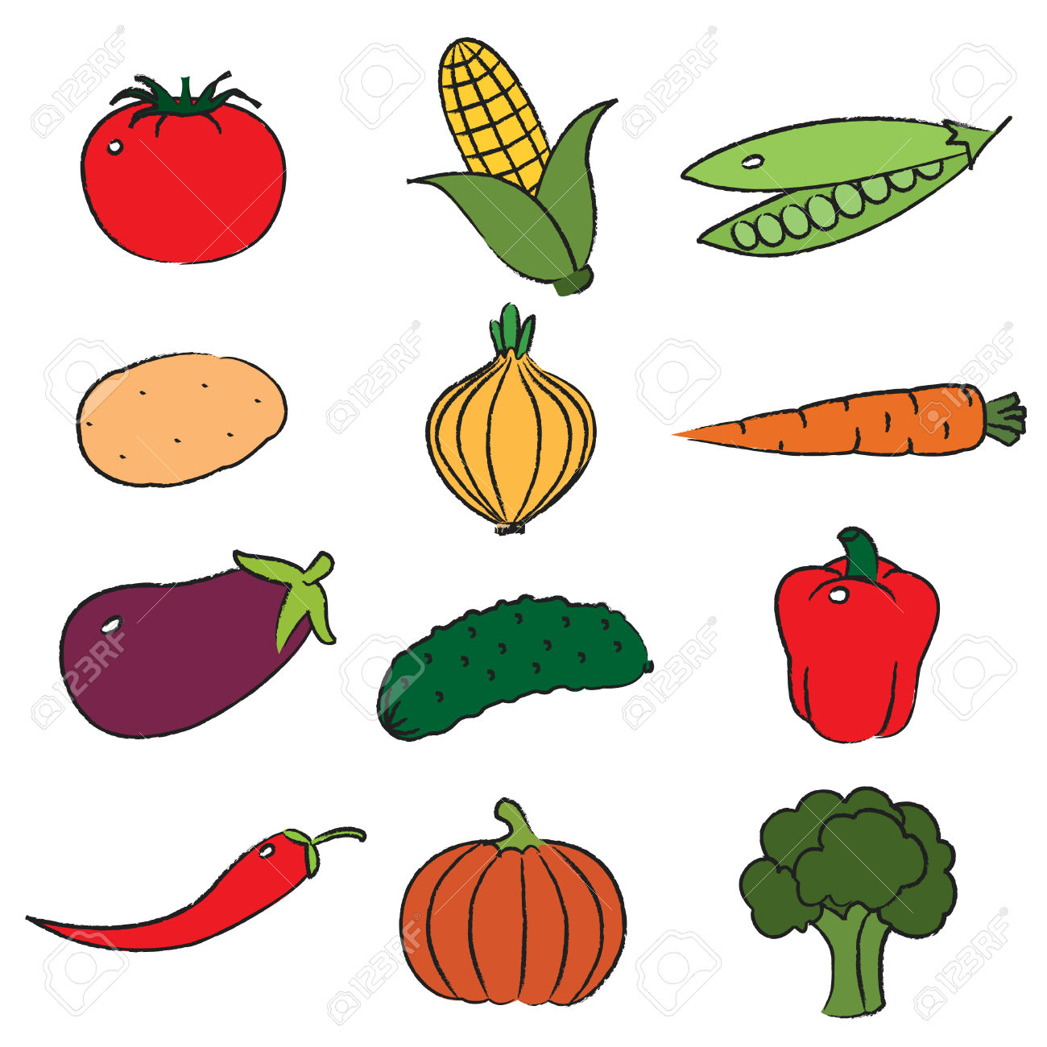
FOOD - VEGETABLES
TOMATO
CORN
PEAS
POTATO
ONION
CARROT
EGGPLANT
CUCUMBER
BELL PEPPER
PUMPKIN
BROCCOLI
CHILI PEPPER

Slide 51
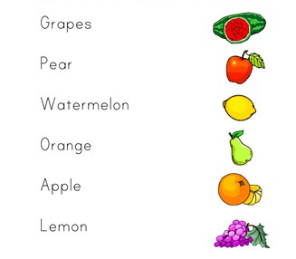
EXERCISE

Slide 52
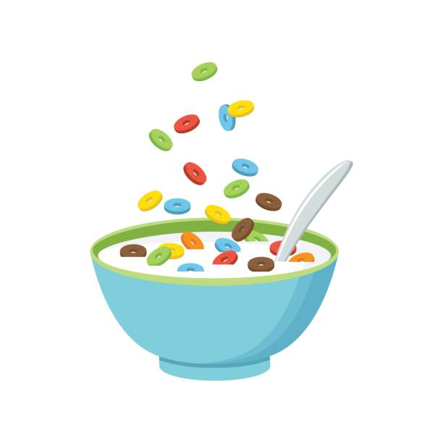
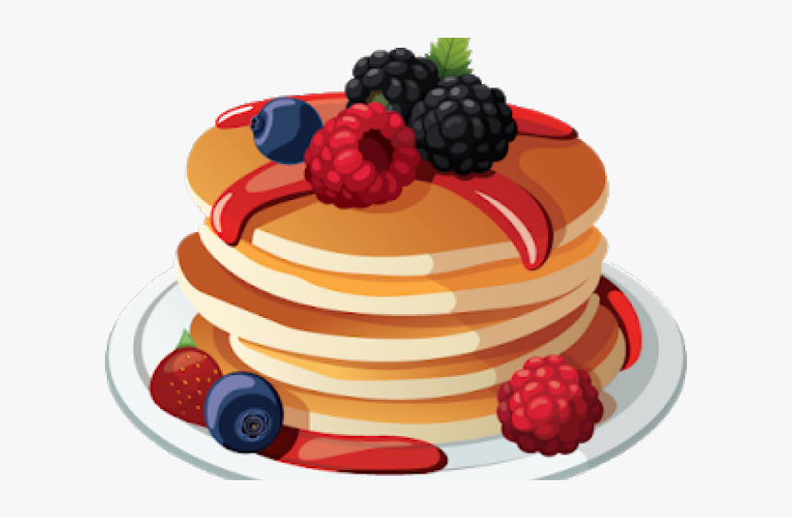

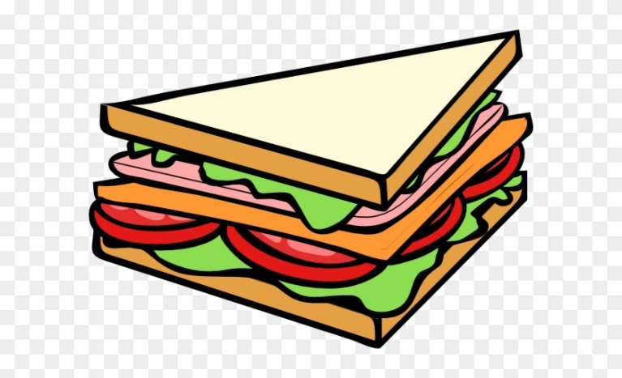
FOOD
CEREAL
PANCAKES
EGGS
SANDWICH
BREAD

Slide 53
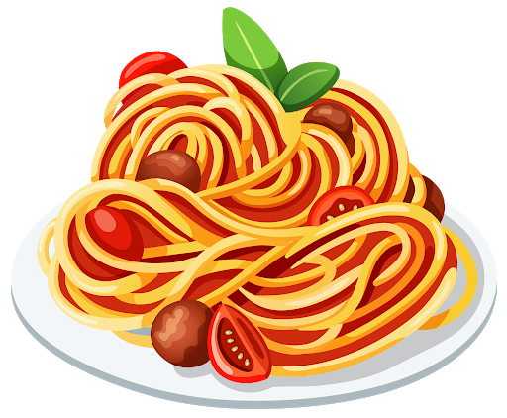

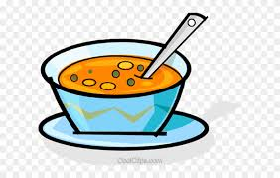

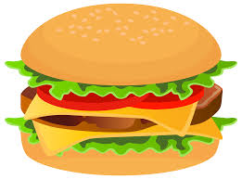
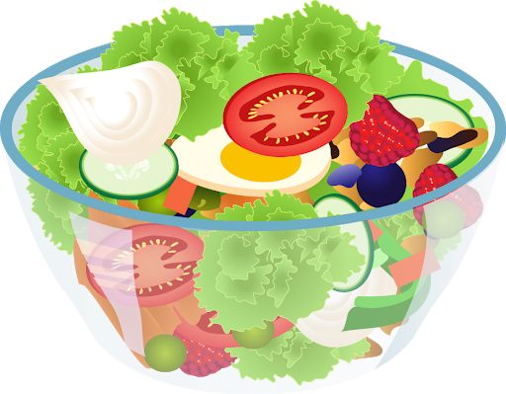
FOOD
SOUP
PASTA
RICE
PIZZA
BURGER
SALAD

Slide 54
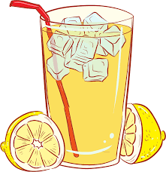
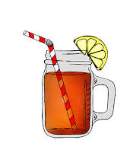

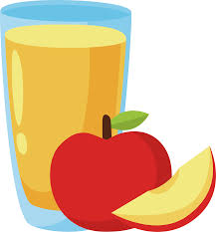

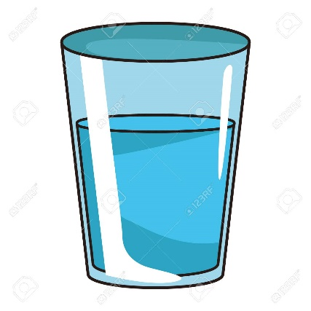
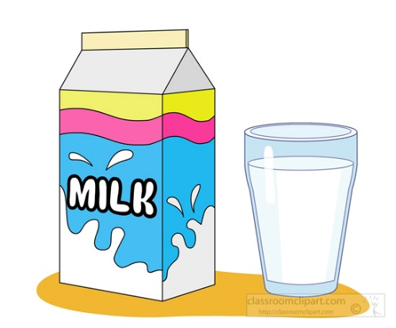

DRINKS
ORANGE JUICE
APPLE JUICE
LEMONADE
ICED TEA
WATER
MILK
TEA
HOT
CHOCOLATE

Slide 55




EXERCISE
PANCAKES
WATER
SOUP
ICED TEA
SALAD
CEREAL

Slide 56
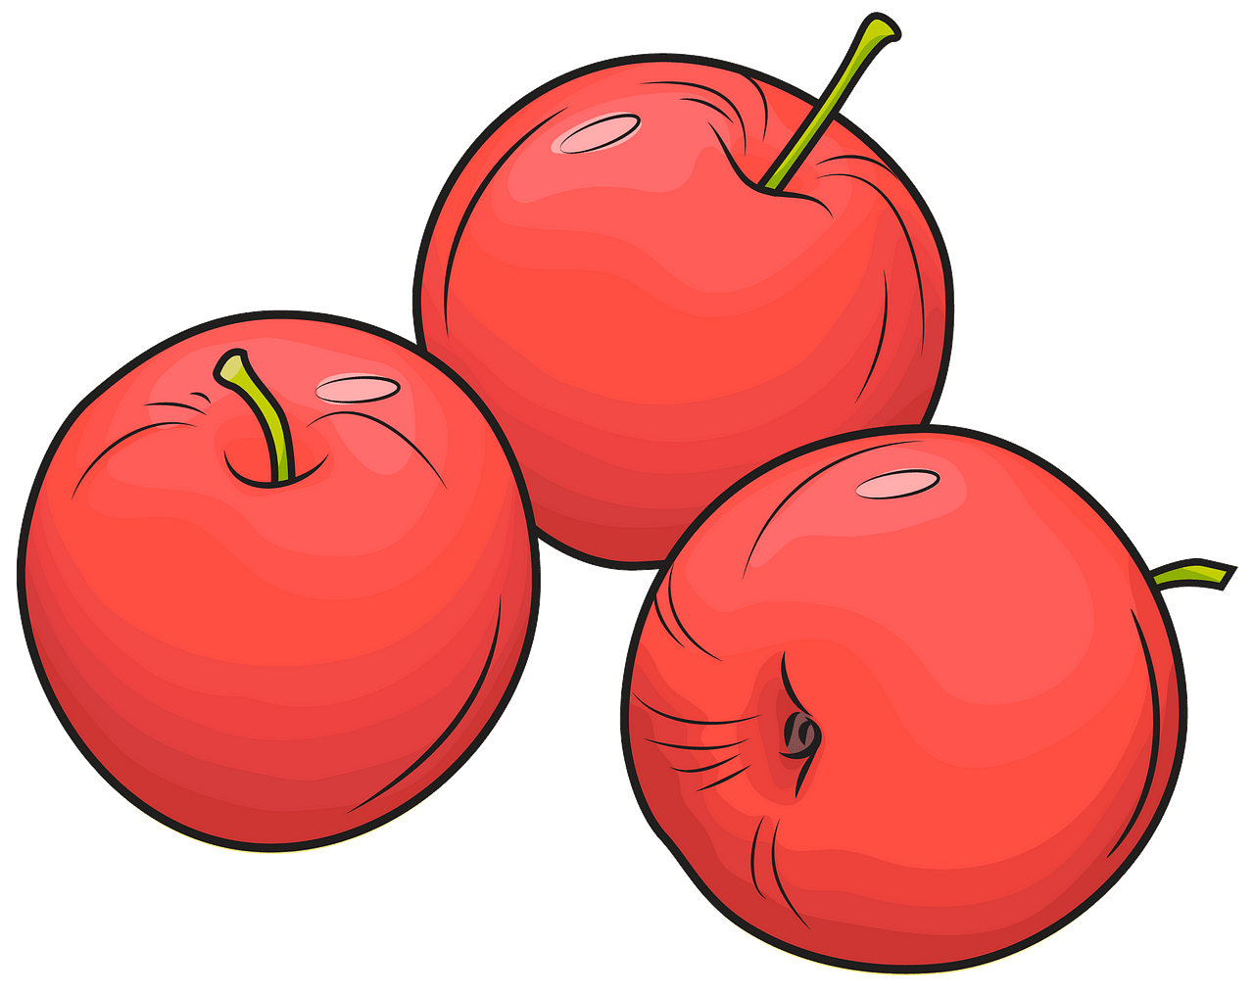
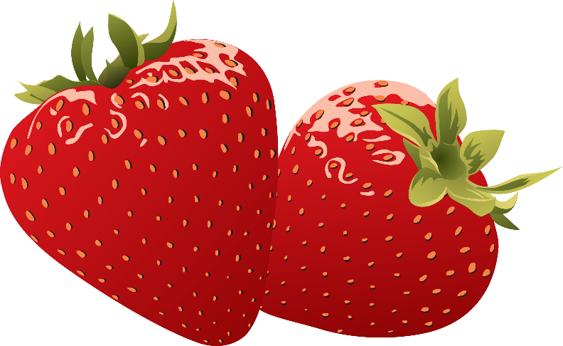

WHAT IS YOUR FAVORITE FRUIT?
MY FAVORITE FRUIT IS …
APPLES
STRAWBERRIES
BANANAS

Slide 57



WHAT IS YOUR FAVORITE VEGETABLE?
MY FAVORITE VEGETABLE IS …
CARROTS
BROCCOLI
CUCUMBERS

Slide 58

WHAT IS YOUR FAVORITE FOOD?
WHAT IS Your FAVORItE DRINK?
MY FAVORITE FOOD IS …
MY FAVORITE DRINK IS …
PASTA
STRAWBERRY JUICE

Slide 59


FAVORITE FRUIT & VEGETABLE
What is his favorite fruit?
What is her favorite vegetable?
His favorite fruit is
peaches.
Her favorite vegetable is
tomatoes.

Slide 60

MY FAMILY
GRANDPARENTS
GRANDFATHER
GRANDPA
GRANDMOTHER
GRANDMA
PARENTS

Slide 61

WHO IS THIS?
THIS IS
MY GRANDPA JACK
THESE ARE
MY GRANDPARENTS
THIS IS
MY GRANDMA MARY

Slide 62
WHO IS THIS?
THIS IS
MY MUM NINA
THESE ARE
MY PARENTS
THIS IS
MY DAD PHIL

Slide 63
WHO IS THIS?
THIS IS
MY SISTER SUSIE
THESE ARE
MY SIBLINGS
THIS IS
MY BROTHER NICK

